Slide 1
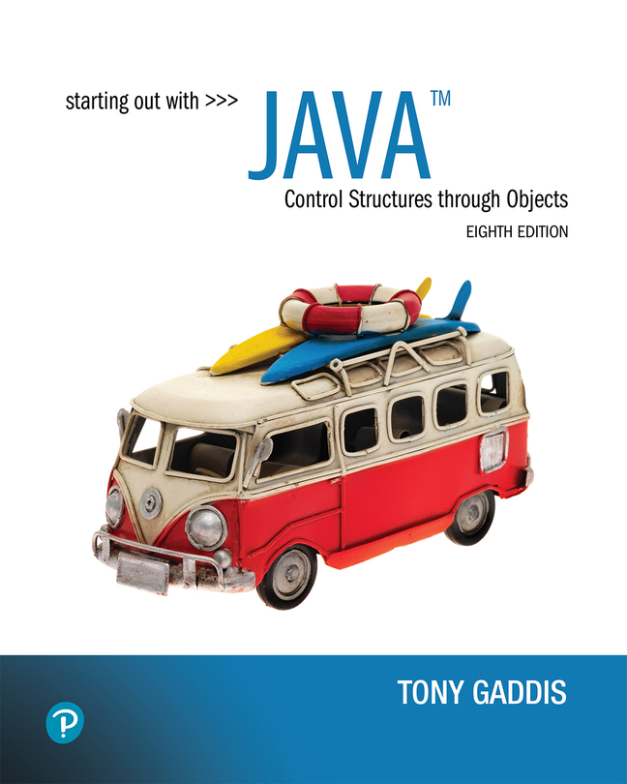

Starting Out with Java Control Structures Through Objects
Eighth Edition
Chapter 10
Inheritance
Copyright © 2022 Pearson Education, Inc. All Rights Reserved
Notes:
If this PowerPoint presentation contains mathematical equations, you may need to check that your computer has the following installed:
1) MathType Plugin
2) Math Player (free versions available)
3) NVDA Reader (free versions available)

Slide 2
Chapter Topics
Chapter 10 discusses the following main topics:
What Is Inheritance?
Calling the Superclass Constructor
Overriding Superclass Methods
Protected Members
Chains of Inheritance
The Object Class
Polymorphism
Abstract Classes and Abstract Methods
Interfaces
Anonymous Classes
Functional Interfaces and Lambda Expressions

Slide 3
What is Inheritance? Generalization versus Specialization
Real-life objects are typically specialized versions of other more general objects.
The term “insect” describes a very general type of creature with numerous characteristics.
Grasshoppers and bumblebees are insects
They share the general characteristics of an insect.
However, they have special characteristics of their own.
grasshoppers have a jumping ability, and
bumblebees have a stinger.
Grasshoppers and bumblebees are specialized versions of an insect.

Slide 4
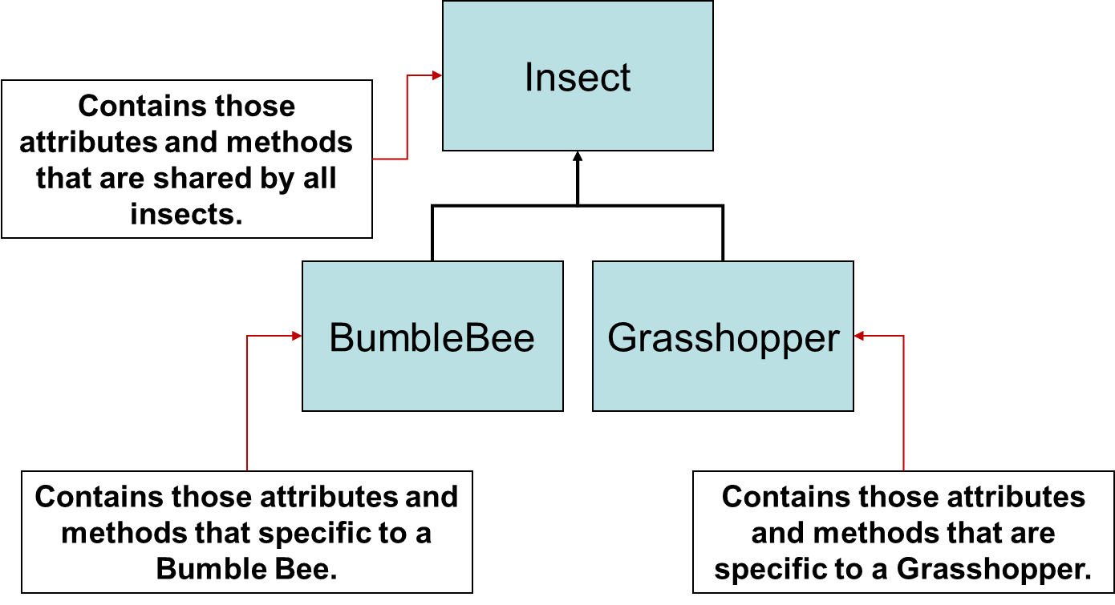
Inheritance (1 of 2)
Notes:
Arrows from Bumblebee and grasshopper extend to the insect. Insect is labeled, contains those attributes and methods that are shared by all insects. Bumblebee is labeled, contains those attributes and methods that are specific to a Bumblebee. Grasshopper is labeled, contains those attributes and methods that are specific to a Grasshopper.

Slide 5
The “is a” Relationship (1 of 2)
The relationship between a superclass and an inherited class is called an “is a” relationship.
A grasshopper “is a” insect.
A poodle “is a” dog.
A car “is a” vehicle.
A specialized object has:
all of the characteristics of the general object, plus
additional characteristics that make it special.
In object-oriented programming, inheritance is used to create an “is a” relationship among classes.

Slide 6
The “is a” Relationship (2 of 2)
We can extend the capabilities of a class.
Inheritance involves a superclass and a subclass.
The superclass is the general class and
the subclass is the specialized class.
The subclass is based on, or extended from, the superclass.
Superclasses are also called base classes, and
subclasses are also called derived classes.
The relationship of classes can be thought of as parent classes and child classes.

Slide 7
Inheritance (2 of 2)
The subclass inherits fields and methods from the superclass without any of them being rewritten.
New fields and methods may be added to the subclass.
The Java keyword, extends, is used on the class header to define the subclass.
public class FinalExam extends GradedActivity

Slide 8
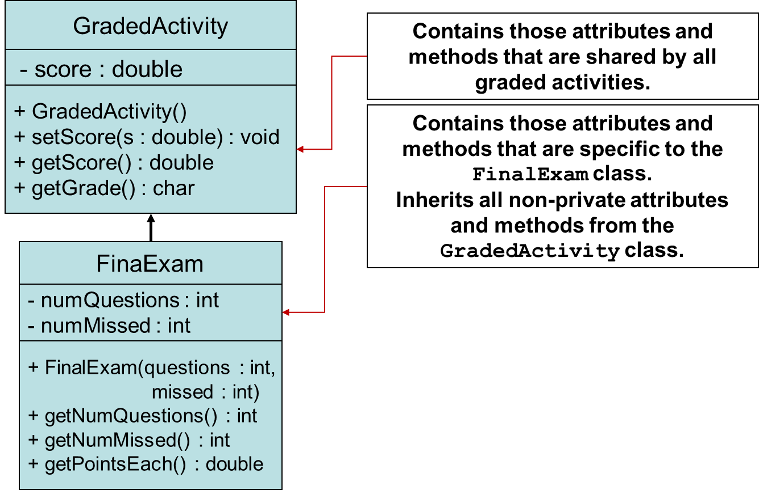
The GradedActivity Example
Example:
GradedActivity.java,
GradeDemo.java,
FinalExam.java,
FinalExamDemo.java
Notes:
The class, final exam, is placed under the class, graded activity. Arrow from Final exam extends to the graded activity. The class, graded activity includes the data as follows. Minus sign score colon double, + Grade Activity left parenthesis right parenthesis + set score left parenthesis s colon double right parenthesis colon void + get score left parenthesis right parenthesis colon double + get Grade left parenthesis right parenthesis colon c h a r. The class, final exam includes the data as follows. Minus sign score n u m Questions colon I n t, minus sign n u m missed colon I n t + final exam left parenthesis questions colon I n t, missed colon I n t right parenthesis. Graded activity is labeled, contains those attributes and methods that are shared by all graded activities. Final exam is labeled, contains those attributes and methods that are specific to the final exam class. Inherits all non private attributes and methods from the graded activity class.

Slide 9
Inheritance, Fields and Methods (1 of 2)
Members of the superclass that are marked private:
are not inherited by the subclass,
exist in memory when the object of the subclass is created
may only be accessed from the subclass by public methods of the superclass.
Members of the superclass that are marked public:
are inherited by the subclass, and
may be directly accessed from the subclass.

Slide 10
Inheritance, Fields and Methods (2 of 2)
When an instance of the subclass is created, the non-private methods of the superclass are available through the subclass object.
FinalExam exam = new FinalExam();
exam.setScore(85.0);
System.out.println("Score = " + exam.getScore());
Non-private methods and fields of the superclass are available in the subclass.
setScore(newScore);

Slide 11
Inheritance and Constructors
Constructors are not inherited.
When a subclass is instantiated, the superclass default constructor is executed first.
Example:
SuperClass1.java
SubClass1.java
ConstructorDemo1.java

Slide 12
The Superclass’s Constructor
The super keyword refers to an object’s superclass.
The superclass constructor can be explicitly called from the subclass by using the super keyword.
Example:
SuperClass2.java, SubClass2.java, ConstructorDemo2.java
Rectangle.java, Cube.java, CubeDemo.java

Slide 13
Calling the Superclass Constructor
If a parameterized constructor is defined in the superclass,
the superclass must provide a no-arg constructor, or
subclasses must provide a constructor, and
subclasses must call a superclass constructor.
Calls to a superclass constructor must be the first java statement in the subclass constructors.

Slide 14
Overriding Superclass Methods (1 of 5)
A subclass may have a method with the same signature as a superclass method.
The subclass method overrides the superclass method.
This is known as method overriding.
Example:
GradedActivity.java, CurvedActivity.java, CurvedActivityDemo.java

Slide 15
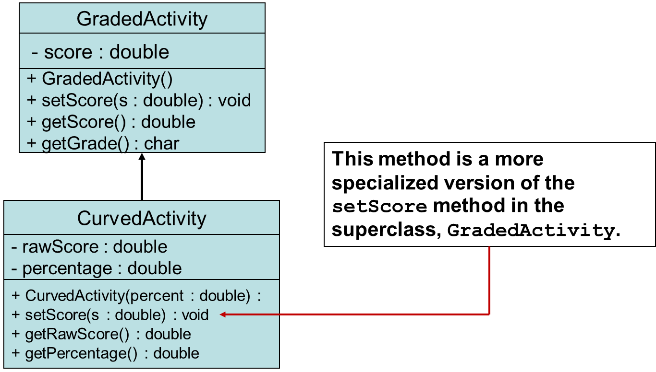
Overriding Superclass Methods (2 of 5)
Notes:
The class, curved activity, is placed under the class, graded activity. Arrow from curved activity extends to the graded activity. The class, graded activity includes the data as follows. Minus sign score colon double, + Grade Activity left parenthesis right parenthesis, + set score left parenthesis s colon double right parenthesis colon void, + get score left parenthesis right parenthesis colon double, + get Grade left parenthesis right parenthesis colon c h a r. The class, curved activity includes the data as follows. Minus sign raw score colon double, minus sign percentage colon double, + curved activity left parenthesis percent colon double right parenthesis colon, + set score left parenthesis s colon double right parenthesis colon void, + get raw score left parenthesis right parenthesis colon double, + get percentage left parenthesis right parenthesis colon double. + set score left parenthesis s colon double right parenthesis colon void is labeled, this method is a more specialized version of the set score method in the superclass, grade activity.

Slide 16
Overriding Superclass Methods (3 of 5)
Recall that a method’s signature consists of:
the method’s name
the data types method’s parameters in the order that they appear.
A subclass method that overrides a superclass method must have the same signature as the superclass method.
An object of the subclass. invokes the subclass’s version of the method, not the superclass’s
The @Override annotation should be used just before the subclass method declaration.
This causes the compiler to display a error message if the method fails to correctly override a method in the superclass.

Slide 17
Overriding Superclass Methods (4 of 5)
An subclass method can call the overridden superclass method via the super keyword.
super.setScore(rawScore * percentage);
There is a distinction between overloading a method and overriding a method.
Overloading is when a method has the same name as one or more other methods, but with a different signature.
When a method overrides another method, however, they both have the same signature.

Slide 18
Overriding Superclass Methods (5 of 5)
Both overloading and overriding can take place in an inheritance relationship.
Overriding can only take place in an inheritance relationship.
Example:
SuperClass3.java,
SubClass3.java,
ShowValueDemo.java

Slide 19
Preventing a Method from Being Overridden
The final modifier will prevent the overriding of a superclass method in a subclass.
public final void message()
If a subclass attempts to override a final method, the compiler generates an error.
This ensures that a particular superclass method is used by subclasses rather than a modified version of it.

Slide 20
Protected Members (1 of 2)
Protected members of class:
may be accessed by methods in a subclass, and
by methods in the same package as the class.
Java provides a third access specification, protected.
A protected member’s access is somewhere between private and public.
Example:
GradedActivity2.java
FinalExam2.java
ProtectedDemo.java

Slide 21
Protected Members (2 of 2)
Using protected instead of private makes some tasks easier.
However, any class that is derived from the class, or is in the same package, has unrestricted access to the protected member.
It is always better to make all fields private and then provide public methods for accessing those fields.
If no access specifier for a class member is provided, the class member is given package access by default.
Any method in the same package may access the member.

Slide 22
Access Specifiers
Access Modifier | Accessible to a subclass inside the same package? | Accessible to all other classes inside the same package?
default (no modifier) | Yes | Yes
Public | Yes | Yes
Protected | Yes | Yes
Private | No | No
Access Modifier | Accessible to a subclass outside the package? | Accessible to all other classes outside the package?
default (no modifier) | No | No
Public | Yes | Yes
Protected | Yes | No
Private | No | No

Slide 23
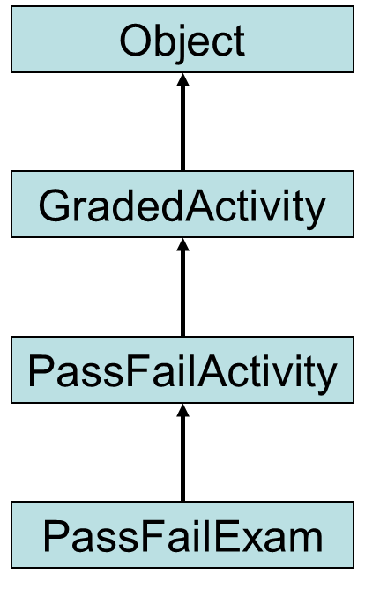
Chains of Inheritance (1 of 2)
A superclass can also be derived from another class.
Example: GradedActivity.java PassFailActivity.java PassFailExam.java PassFailExamDemo.java

Slide 24
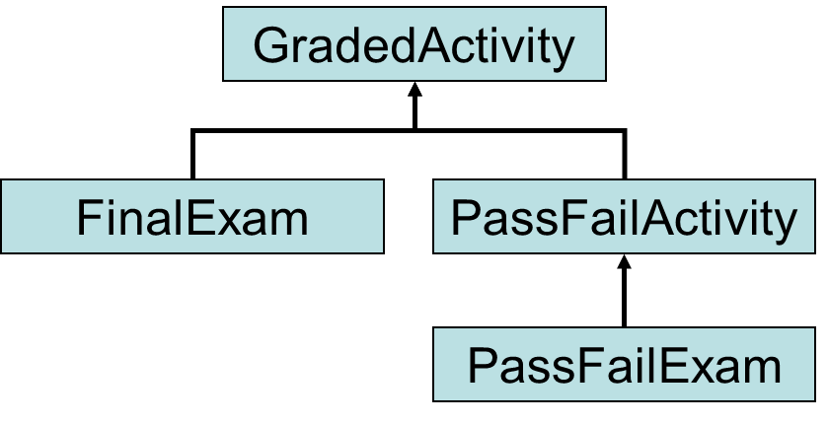
Chains of Inheritance (2 of 2)
Classes often are depicted graphically in a class hierarchy.
A class hierarchy shows the inheritance relationships between classes.
Notes:
The classes, final exam and pass fail activity are placed under the other Graded activity. The class, pass fail exam is placed under the pass fail activity. Arrows from fail exam and pass fail activity extend to graded activity. Up arrow extends from pass fail exam to pass fail activity.

Slide 25
The Object Class (1 of 2)
All Java classes are directly or indirectly derived from a class named Object.
Object is in the java.lang package.
Any class that does not specify the extends keyword is automatically derived from the Object class.
public class MyClass
{
// This class is derived from Object.
}
Ultimately, every class is derived from the Object class.

Slide 26
The Object Class (2 of 2)
Because every class is directly or indirectly derived from the Object class:
every class inherits the Object class’s members.
example: toString and equals.
In the Object class, the toString method returns a string containing the object’s class name and a hash of its memory address.
The equals method accepts the address of an object as its argument and returns true if it is the same as the calling object’s address.
Example: ObjectMethods.java

Slide 27
Polymorphism (1 of 3)
A reference variable can reference objects of classes that are derived from the variable’s class.
GradedActivity exam;
We can use the exam variable to reference a GradedActivity object.
exam = new GradedActivity();
The GradedActivity class is also used as the superclass for the FinalExam class.
An object of the FinalExam class is a GradedActivity object.

Slide 28
Polymorphism (2 of 3)
A GradedActivity variable can be used to reference a FinalExam object.
GradedActivity exam = new FinalExam(50, 7);
This statement creates a FinalExam object and stores the object’s address in the exam variable.
This is an example of polymorphism.
The term polymorphism means the ability to take many forms.
In Java, a reference variable is polymorphic because it can reference objects of types different from its own, as long as those types are subclasses of its type.

Slide 29
Polymorphism (3 of 3)
Other legal polymorphic references:
GradedActivity exam1 = new FinalExam(50, 7);
GradedActivity exam2 = new PassFailActivity(70);
GradedActivity exam3 = new PassFailExam(100, 10, 70);
The GradedActivity class has three methods: setScore, getScore, and getGrade.
A GradedActivity variable can be used to call only those three methods.
GradedActivity exam = new PassFailExam(100, 10, 70);
System.out.println(exam.getScore()); // This works.
System.out.println(exam.getGrade()); // This works.
System.out.println(exam.getPointsEach()); // ERROR!

Slide 30
Polymorphism and Dynamic Binding
If the object of the subclass has overridden a method in the superclass:
If the variable makes a call to that method the subclass’s version of the method will be run.
GradedActivity exam = new PassFailActivity(60);
exam.setScore(70);
System.out.println(exam.getGrade());
Java performs dynamic binding or late binding when a variable contains a polymorphic reference.
The Java Virtual Machine determines at runtime which method to call, depending on the type of object that the variable references.

Slide 31
Polymorphism
It is the object’s type, rather than the reference type, that determines which method is called.
Example:
Polymorphic.java
You cannot assign a superclass object to a subclass reference variable.

Slide 32
Abstract Classes
An abstract class cannot be instantiated, but other classes are derived from it.
An Abstract class serves as a superclass for other classes.
The abstract class represents the generic or abstract form of all the classes that are derived from it.
A class becomes abstract when you place the abstract key word in the class definition.
public abstract class ClassName

Slide 33
Abstract Methods (1 of 2)
An abstract method has no body and must be overridden in a subclass.
An abstract method is a method that appears in a superclass, but expects to be overridden in a subclass.
An abstract method has only a header and no body.
AccessSpecifier abstract ReturnType MethodName(ParameterList);
Example:
Student.java, CompSciStudent.java, CompSciStudentDemo.java

Slide 34
Abstract Methods (2 of 2)
Notice that the key word abstract appears in the header, and that the header ends with a semicolon.
public abstract void setValue(int value);
Any class that contains an abstract method is automatically abstract.
If a subclass fails to override an abstract method, a compiler error will result.
Abstract methods are used to ensure that a subclass implements the method.

Slide 35
final Classes
A final class cannot be inherited from
public final class YourClass
{
// Member declarations
}
A compiler error will occur if any other class tries to inherit from a final class.
Although a final class cannot be inherited from, it can inherit from a base class.

Slide 36
final Methods
A final method cannot be overridden in a subclass.
public class MyClass
{
public final void message()
{
// Code goes here
}
}
In this example, the message method is final, so it cannot be overridden in any class that inherits from MyClass.
This technique can be used to make sure that a superclass method is used by subclasses and not a modified version of it.

Slide 37
Interfaces (1 of 3)
An interface is similar to an abstract class that has all abstract methods.
It cannot be instantiated, and
all of the methods listed in an interface must be written elsewhere.
The purpose of an interface is to specify behavior for other classes.
It is often said that an interface is like a “contract,” and when a class implements an interface it must adhere to the contract.
An interface looks similar to a class, except:
the keyword interface is used instead of the keyword class, and
the methods that are specified in an interface have no bodies, only headers that are terminated by semicolons.

Slide 38
Interfaces (2 of 3)
The general format of an interface definition:
public interface InterfaceName
{
(Method headers...)
}
All methods specified by an interface are public by default.
A class can implement one or more interfaces

Slide 39
Interfaces (3 of 3)
If a class implements an interface, it uses the implements keyword in the class header.
public class FinalExam3 extends GradedActivity implements Relatable
Example:
GradedActivity.java
Relatable.java
FinalExam3.java
InterfaceDemo.java

Slide 40
Fields in Interfaces
An interface can contain field declarations:
all fields in an interface are treated as final and static.
Because they automatically become final, you must provide an initialization value.
public interface Doable
{
int FIELD1 = 1, FIELD2 = 2;
(Method headers...)
}
In this interface, FIELD1 and FIELD2 are final static int variables.
Any class that implements this interface has access to these variables.

Slide 41
Implementing Multiple Interfaces
A class can be derived from only one superclass.
Java allows a class to implement multiple interfaces.
When a class implements multiple interfaces, it must provide the methods specified by all of them.
To specify multiple interfaces in a class definition, simply list the names of the interfaces, separated by commas, after the implements key word.
public class MyClass implements Interface1,
Interface2,
Interface3

Slide 42
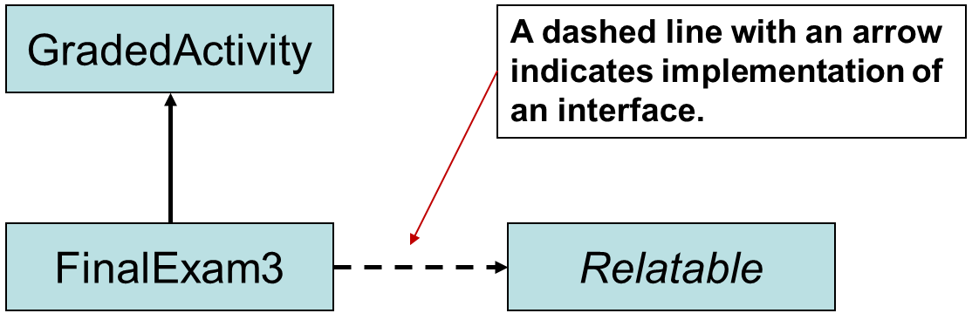
Interfaces in U M L
Notes:
The class, final exam 3 is placed under graded activity. Up Arrow extends from fail exam 3 to graded activity. A dashed arrow extends from final exam 3 to relatable. Dashed line is labeled, a dashed line with an arrow indicates implementation of an interface.

Slide 43
Default Methods
Beginning in Java 8, interfaces may have default methods.
A default method is an interface method that has a body.
You can add new methods to an existing interface without causing errors in the classes that already implement the interface.
Example:
Displayable.java
Person.java
InterfaceDemoDefaultMethod.java

Slide 44
Private Interface Methods (1 of 3)
Starting with Java 9, interfaces can have private methods.
Private interface methods are useful in the following situations:
An interface has a default method containing a lot of complex code that should be broken up into smaller methods.
An interface has two or more default methods that use the same code. Instead of duplicating code in each default method, the shared code can be put into a private method that is called by each default method.
An interface's private methods can be accessed only by code in the interface.
They cannot be overridden in classes that implement the interface.

Slide 45
Private Interface Methods (2 of 3)
Example (general format):
public interface MyInterface
{
public default void myDefaultMethod()
{
myPrivateMethod1();
myPrivateMethod2();
}
private void myPrivateMethod1()
{
// statement
// statement
// statement
}
private void myPrivateMethod2()
{
// statement
// statement
// statement
}
}

Slide 46
Private Interface Methods (3 of 3)
Private interface methods must have a body.
You do not use the default keyword in the header of a private interface method.

Slide 47
Polymorphism with Interfaces (1 of 3)
Java allows you to create reference variables of an interface type.
An interface reference variable can reference any object that implements that interface, regardless of its class type.
This is another example of polymorphism.
Example:
RetailItem.java
DigitalSong.java
DigitalMovie.java
PolymorphicInterfaceDemo.java

Slide 48
Polymorphism with Interfaces (2 of 3)
In the example code, a method named showPrice has a RetailItem reference variable as its parameter.
Any object that implements the RetailItem interface can be passed as an argument to the method.
When a class implements an interface, an inheritance relationship known as interface inheritance is established.
a DigitalSong object is a RetailItem, and
a DigitalMovie object is a RetailItem.

Slide 49
Polymorphism with Interfaces (3 of 3)
A reference to an interface can point to any class that implements that interface.
You cannot create an instance of an interface.
RetailItem item = new RetailItem(); // ERROR!
When an interface variable references an object:
only the methods declared in the interface are available,
explicit type casting is required to access the other methods of an object referenced by an interface reference.

Slide 50
Arrays and ArrayLists of Interface References (1 of 4)
The following code creates an array of RetailItem objects:
RetailItem[] items = {
new DigitalSong("Wipe The Tears From My Eyes",
"Billy Nelson", 1.00),
new DigitalSong("Sunshine On My shoulder",
"Joe Looney", 0.99),
new DigitalMovie("It Came From Planet X",
102, 4.95),
new DigitalMovie("A Night In Paris",
124, 5.95)
};
Notice that some of the objects are DigitalSong and some are DigitalMovie

Slide 51
Arrays and ArrayLists of Interface References (2 of 4)
The following code iterates over the previously shown array, displaying each element's retail price:
for (var item : items)
{
System.out.println(item.getRetailPrice());
}

Slide 52
Arrays and ArrayLists of Interface References (3 of 4)
The following code creates an ArrayList of RetailItem objects:
var itemList = new ArrayList<RetailItem>();
itemList.add(new DigitalSong("Wipe The Tears From My Eyes",
"Billy Nelson", 1.00));
itemList.add(new DigitalSong("Sunshine On My shoulder",
"Joe Looney", 0.99));
itemList.add(new DigitalMovie("It Came From Planet X",
102, 4.95));
itemList.add(new DigitalMovie("A Night In Paris",
124, 5.95));
Notice that some of the objects are DigitalSong and some are DigitalMovie

Slide 53
Arrays and ArrayLists of Interface References (4 of 4)
The following code iterates over the previously shown ArrayList, displaying each element's retail price:
for (var item : itemList)
{
System.out.println(item.getRetailPrice());
}

Slide 54
Anonymous Inner Classes (1 of 3)
An inner class is a class that is defined inside another class.
An anonymous inner class is an inner class that has no name.
An anonymous inner class must implement an interface or extend another class.
Useful when you need a class that is simple, and to be instantiated only once in your code.
Example:
IntCalculator.java
AnonymousClassDemo.java

Slide 55
Anonymous Inner Classes (2 of 3)
Suppose we have this interface:
interface IntCalculator
{
int calculate(int number);
}
The following defines an anonymous class that implements the IntCalculator interface and overrides the calculate method:
IntCalculator square = new IntCalculator() {
public int calculate(int number)
{
return number * number;
}};

Slide 56
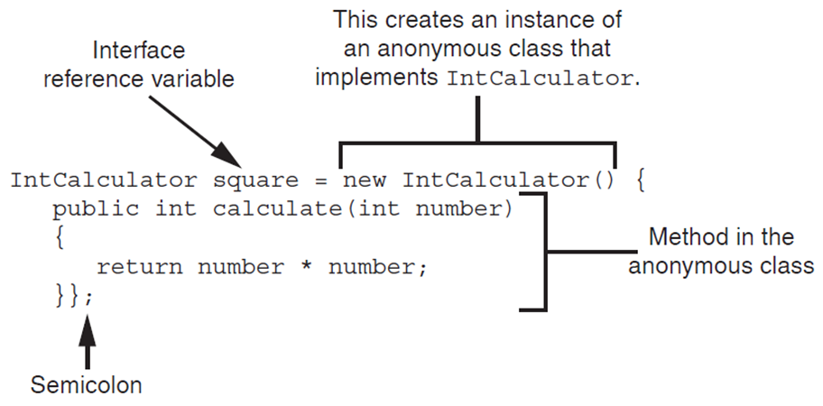
Anonymous Inner Classes (3 of 3)
See:
IntCalculator.java
AnonymousClassDemo.java
Notes:
The program code is as follows. Line 1. I n t calculator square = new I n t calculator left parenthesis right parenthesis left brace. In line 1, square is labeled, interface reference variable and new I n t calculator left parenthesis right parenthesis is labeled, this creates an instance of an anonymous class that implements I n t calculator. Line 2. Indented once, public I n t calculate left parenthesis I n t number right parenthesis. Line 3. Indented once, left brace. Line 4. Indented twice, return number times number semicolon. Line 5. Indented once, right brace right brace semicolon. Lines 2 to 5 are together labeled, method in the anonymous class. In line 5, the semicolon is also labeled.

Slide 57
Functional Interfaces and Lambda Expressions (1 of 6)
A functional interface is an interface that has one abstract method.
Example:
interface IntCalculator
{
int calculate(int number);
}

Slide 58
Functional Interfaces and Lambda Expressions (2 of 6)
A lambda expression can be used to create an object that implements a functional interface and overrides its abstract method.
These features work together to simplify code, particularly in situations where you might use anonymous inner classes.
Think of a lambda expression as an anonymous method, or a method with no name.

Slide 59
Functional Interfaces and Lambda Expressions (3 of 6)
General format of a lambda expression that accepts one argument and returns a value:
parameter −> expression
The lambda expression begins with a parameter variable, followed by the lambda operator (−>), followed by an expression that has a value.

Slide 60
Functional Interfaces and Lambda Expressions (4 of 6)
Example:
x −> x * x
The x on the left side of the −> operator is the name of the parameter variable
The expression x * x that appears on the right side of the −> operator is the value that is returned
This expression works like a method that has a parameter variable named x and it returns the value of x * x

Slide 61
Functional Interfaces and Lambda Expressions (5 of 6)
We can use the previously shown lambda expression to create an object that implements the IntCalculator interface.
Example:
IntCalculator square = x −> x * x;
On the left side of the = operator we declare an IntCalculator reference variable named square
On the right side of the = operator we have a lambda expression that creates an IntCalculator object and overrides the calculate method
The parameter x represents the calculate method’s parameter and the expression x * x is the value returned from the calculate method

Slide 62
Functional Interfaces and Lambda Expressions (6 of 6)
Example usage:
IntCalculator square = x −> x * x;
int result = square.calculate(4);
This code will assign 16 to the result variable
See:
LambdaDemo.java
LambdaDemo2.java

Slide 63

Copyright
This work is protected by United States copyright laws and is provided solely for the use of instructors in teaching their courses and assessing student learning. Dissemination or sale of any part of this work (including on the World Wide Web) will destroy the integrity of the work and is not permitted. The work and materials from it should never be made available to students except by instructors using the accompanying text in their classes. All recipients of this work are expected to abide by these restrictions and to honor the intended pedagogical purposes and the needs of other instructors who rely on these materials.

